Slide 1

UNIVERSITY OF TORONTO
CYBERSECURITY BOOTCAMP 2023
SSH HoneyPot
Presented by: Arun Vigneswaran
William Cruickshank
Oscar Mera Burbano

Slide 2
Summary of Project
Tools and Technology
Overview of the Demonstration
Summary of Findings
Mitigation and Defence
Table of Content

Slide 3

Summary
The topic selected by our team is a demonstration of honeypots, which serves as an instructive and captivating method to exemplify the enhancement of cybersecurity techniques through the comprehension of attacker behaviour and the utilization of deception tactics.
The fundamental objective of our work is to emphasize the critical significance of implementing The HoneyPot and conducting thorough surveillance of our servers.
The utilization of this comprehensive methodology allows for rigorous monitoring and identification of unauthorized individuals attempting to gain access.
In essence, this procedure enables us to not only discern these offenders but also unveil any nascent susceptibilities they may endeavour to manipulate.
The demonstration will incorporate several security concepts, namely Threat Detection, Attack Analysis, Security Awareness, and Risk Mitigation.

Slide 4

Tools & Technology

Slide 5





Technology
The execution of our project required that we make use of the infrastructure provided by Google Cloud as well as the Linux operating system, in particular Ubuntu.
Throughout the process, we were successful in integrating the more advanced capabilities of SSHPry2.0, which was a major contributor to the accomplishment of our cybersecurity goals.

Slide 6

Google Cloud | Our honeypot was hosted on Google Cloud, which is an all-encompassing suite of cloud computing services supplied by Google. This was the platform that we used to host our honeypot. By going with Google Cloud, we were able to take advantage of its many strengths, including its scalability, stability, security, and innovative capabilities, all of which contributed significantly to the success of our project.
Linux Operating system | Our group made the conscious decision to use Linux, an open-source lineage of Unix-like operating systems centred around the Linux kernel, as the operating system for our server. Linux is a branch of the Unix operating system family. Our team's prior knowledge and competence with this operating system had a role in the decision-making process for this option. In addition, Linux's laudable qualities of dependability, security, and configurability made it an exceptionally well-thought-out and organized option to go with.
SSHPry2.0 | SSHPry 2.0 is an advanced application that was developed specifically for the purpose of monitoring and managing client terminal sessions (TTY) that are connected to SSH. The wide variety of features and capabilities offered by SSHPry 2.0 was a major factor in our group's decision to using it. These features and capabilities include the capability to take control of a victim's terminal emulation (TTY), the incorporation of an inherent keylogger, and the execution of console-level phishing methods.

Slide 7
Overview of the Demonstration

Slide 8
Hacker Finding Important Information from Front End Web Server: The hacker initiates reconnaissance by probing the company's front-end web server. Through various techniques, the hacker extracts sensitive information, such as employee names, email addresses, and other data that can be valuable for a targeted attack.
Hacker Performing Brute Force Attack with Metasploit: The hacker utilizes Metasploit, a widely-used penetration testing tool, to execute a brute force attack on the SSH service of the honeypot. By employing a precompiled password list, the hacker systematically attempts different password combinations until a successful SSH authentication is achieved.
Alert Script for SSH Session Opened on Honeypot: A dedicated script monitors the honeypot's SSH service. When an SSH session is initiated, the script promptly triggers an alert, notifying the Security Operations Center (SOC) analyst via email or a designated messaging platform. This real-time notification allows for immediate response to potential threats.
SSHPry 2.0 Usage for Intrusion Tracking: Leveraging SSHPry 2.0, the security team gains insight into the hacker's actions within the SSH session. SSHPry 2.0 records and logs all movements and commands executed by the hacker, creating a detailed timeline of their activities. This data aids in understanding the extent of the intrusion and any malicious intentions.
IP Blacklisting to Secure Actual Server: Armed with information from the honeypot's monitoring, the SOC analyst swiftly identifies the hacker's IP address. The analyst then takes proactive measures by blacklisting this IP address on the actual server's firewall. This preventative action safeguards the server from any potential unauthorized access attempts originating from the hacker's IP.
This comprehensive demonstration showcases a proactive approach to cybersecurity, highlighting the importance of deception techniques (like honeypots), rapid intrusion detection and response, behavior tracking within compromised sessions, and immediate mitigation strategies against potential threats.

Slide 9



Nexlux Innovations
The company website of Nexlux Innovation was hosted on our Google Cloud infrastructure. During this period, an unauthorized individual undertook reconnaissance activities.
The perpetrator successfully identified potential usernames, which were subsequently exploited in an attempt to gain unauthorized access to the server via SSH.
www.nexluxinnovation.com

Slide 10

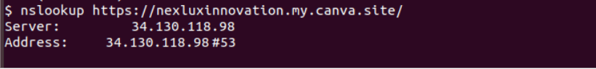
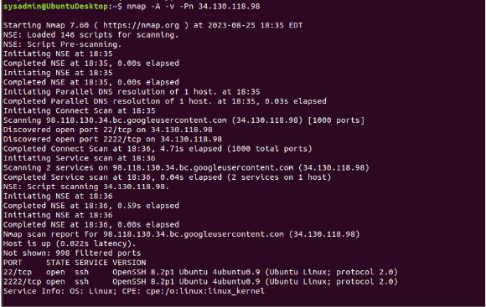
Attack
Evidence
The hacker then used nslookup on “https://nexluxinnovation.my.canva.site/” to find the server IP and address.
Subsequently, the hacker employed nMap, a network scanning tool, to identify accessible ports on the server, which was configured as a
honeypot.
The individual with unauthorized access ascertained that port 22 and port 2222 were in an open state.

Slide 11
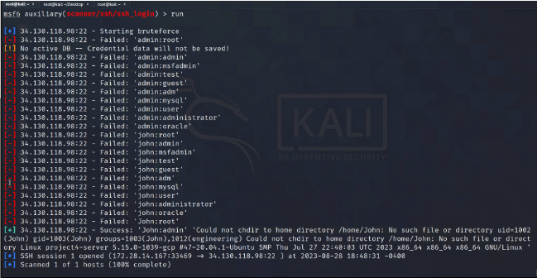


The hacker made the decision to employ the metasploit framework following the nMap scan.
Specifically, they choose to utilize the "auxiliary/scanner/ssh/ssh_login" module in an attempt to carry out an SSH brute force attack, employing a list of passwords.
The hacker effectively established an SSH session on our backend server.

Slide 12
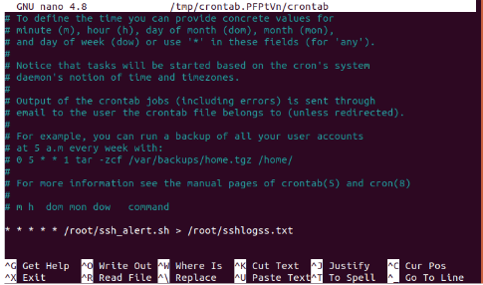
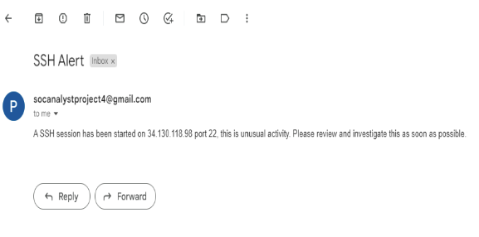
As a result of the crontab-based alert system that was established, the Security Operations Center (SOC) analyst promptly received an email notification.
This alert communicated the initiation of an SSH session, thereby indicating the presence of a malicious intruder within the server, specifically the honeypot.

Slide 13


Slide 14

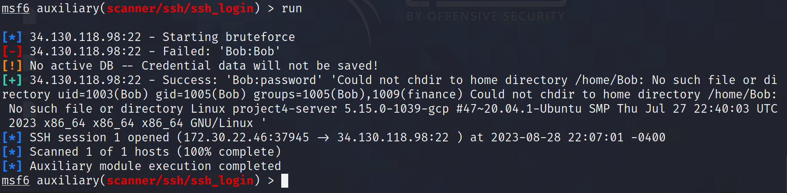
The hacker effectively carried out a brute force assault on the user account named "Bob" using the "auxiliary/scanner/ssh/ssh_login" module, with the assistance of a password list. Following this, the hacker was able to obtain unauthorized entry by effectively opening an SSH session onto our backend server.

Slide 15


Slide 16
Summary of Findings

Slide 17

Summary of Findings
A simulated assault on our system was effectively carried out, nearly mirroring the potential path of a typical attacker.
A notification system was implemented to alert the Security Operations Centre (SOC) staff through email whenever there is an occurrence of SSH access to the honeypot.
The Security Operations Centre (SOC) expeditiously adds the attacker's IP address to the blacklist and proceeds to do a comprehensive analysis of the attacker's tactics employed within the honeypot environment.
The process of analysis presents a significant educational opportunity, as it contributes to the expansion of information regarding developing attack tactics and the improvement of mitigation strategies.
The honeypot serves as a segregated server within our network, enabling us to experiment with and gain insights on server configurations without impacting our primary site. This setup allows for the convenient reorganization of our server infrastructure to support testing and educational purposes.
Various attack vectors can be examined, such as intentionally exposing weaknesses in components like the Server Message Block (SMB) or emulated mail server.
The utilization of a particular approach enhances comprehension and readiness in the face of a diverse range of possible hazards.

Slide 18
Mitigation
&
Defence

Slide 19
Mitigation & Defence
Isolation is a crucial aspect to consider when implementing a honeypot. It is imperative to ensure that the honeypot is physically or logically separated from the principal network, and is instead located within an isolated and regulated environment.
Restricted Services: Enable just necessary services on the honeypot, while disabling any redundant services that could potentially provide attackers with extra opportunities for exploitation.
The implementation of robust monitoring and alert mechanisms on the honeypot is crucial in order to swiftly detect and identify any potentially suspicious actions. It is advisable to conduct regular examinations of system logs and notifications.
Recommendation: It is advisable to regularly update the honeypot's system with the most recent patches in order to prevent widely recognized vulnerabilities and reduce the risk of potential threats.
Experimentation: Consistently expose the honeypot to simulated assaults or efforts to get access, hence supporting the improvement of mitigation techniques and augmenting overall readiness.

Slide 20

Do you have
any questions?

